Slide 1


Microsoft Student Accelerator
Inspire. Develop. Innovate.

Slide 2

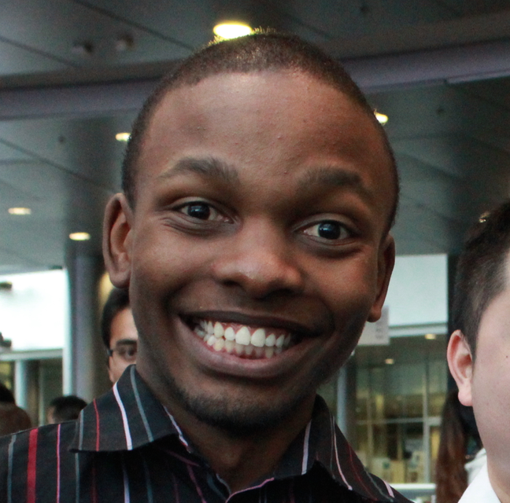

Meet the Team!
Vishesh Oberoi
Technical Evangelist, Microsoft
@ovishesh
Brian Mbuba
Microsoft Student Partner
Jason Goodsell
Microsoft Student Partner

Slide 3
Agenda!
Time | Session
00 | Introduction and Overview
10 | Construct 2 Showcase
25 | Azure Benefits Activation
45 | Prepare Game and Add Functionality
10 | Azure Overview
20 | Implement Scoring and Leader Board with Azure
50 | BREAK
00 | Facebook Integration
30 | Publish game
45 | Recap and Future-looking
55 | END

Slide 4
Microsoft Student Accelerator
Inspire. Develop. Innovate.

Slide 5
Develop.
Tertiary Students
Across the Academic Year
Deep-dive Technical Workshops
10-week Industry Placement
http://msa.ms/

Slide 6
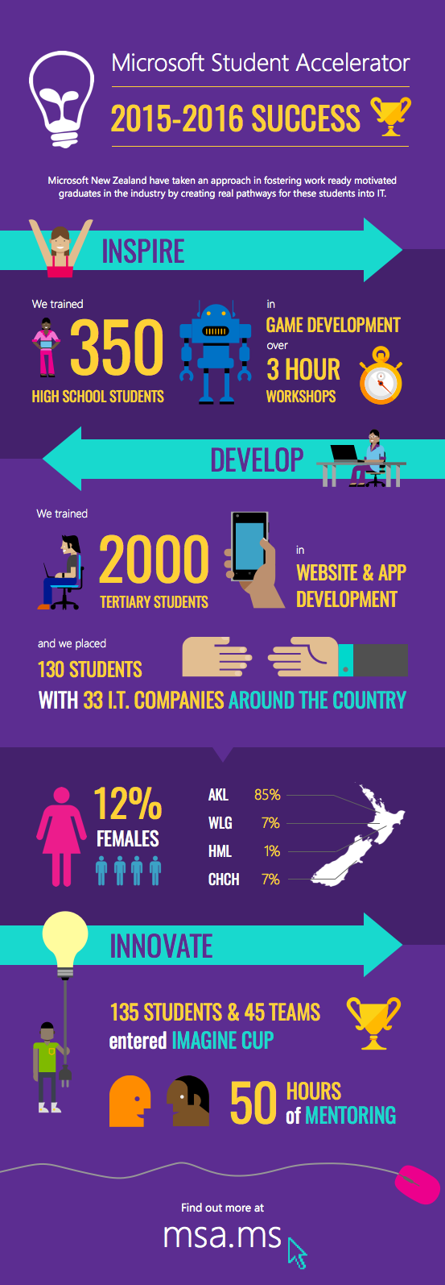

Slide 7
Innovate.
Tertiary and High School Students
Innovation International Student Competition
Industry Mentoring
National Top Prizes
http://msa.ms/imaginecup

Slide 8
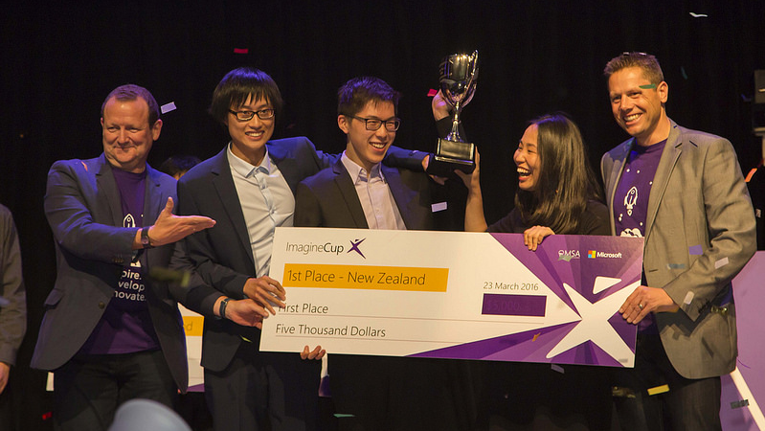
Imagine Cup
New Zealand Winner 2016 – Team Clove

Slide 10
What is Microsoft?
Doyouevencomputer?

Slide 11





Microsoft’s mission
Empower every person and every organization on the planet to achieve more
Notes:
Every great organization needs an enduring mission. And a company with Microsoft’s scale, history, and ambition needs one that fits our appetite for impact. A noble goal. A challenge worth the effort.
And we found one, hiding in plain sight. It’s a mission that connects back to our earliest days as a company, but is aimed directly at the opportunities and challenges that the world will face in the decades to come.
We will empower every person and every organization on the planet to achieve more.
The language is plain, but the implications are profound. So let’s take a moment to unpack this idea and what it means for us, our partners, and our customers.
Empowerment has always been at the core of our industry. It’s a word that gets thrown around frequently but is seldom examined. Of course at its core, it means to give somebody power. But how do we do that? And the power to do what? We think the answer is best kept simple:
When we talk about empowering people we simply mean that with the right tools, anyone can become anything.
But perhaps “on the planet” is the most important and interesting idea in our mission. Because here we sit, at a moment in history that is equal parts thrilling and frustrating.
We have unprecedented power, offset by untapped potential.
We will empower, not just every person and organization, but every person and every organization on the planet to achieve more.

Slide 12



Empower every person and every organization on the planet to achieve more
Build the intelligent cloud
Reinvent productivity & business process
Create more personal computing

Slide 13


Empower every person and every organization on the planet to achieve more
Build the intelligent cloud
Reinvent productivity & business process
Create more personal computing

Slide 14
Hybrid capabilities
tools
Visual Studio + Visual Studio Code + Visual Studio Team Services + Xamarin
Advanced Workloads
Microsoft Azure
Web + Mobile Internet of Things
Microservices
Data + Analytics
Identity Management
Media Streaming
High Performance Compute
Cognitive Services
CORE Infrastructure
Compute Storage Networking Security

Slide 15





Notes:
We’ve been around a long time and we’ve disrupted together – thanks in large part to the partners in the room, we evolved the operating system market and helped establish Graphical User Interfaces
We changed the word processing and spreadsheet world with integrated productivity in Office
And we changed the datacenter landscape by bringing affordable server software to businesses running on commodity PCs
So we have been a big disruptor in the industry…
…and we have been disrupted a few times as well.
The lessons we’ve learned are evidenced everywhere in the transformation Microsoft is undergoing today
In fact, we are in the middle of a disruption to ourselves right now.
Why would a company with such an incredibly successful software business, reinvent itself?
That is exactly what we did with Office 365.
The 90’s we built the leading productivity software in each category.
In the 00’s we integrated our Office investment and reached to servers with SharePoint and Exchange
Over the last 5 years we’ve been on our latest step to devices and the cloud…
Office is an incredibly successful franchise. Today we serve over a billion users who spend on average 2-3 hours a day with it.
And yet, we knew we needed to shift the business to a mobile first, cloud first business
And today we’ve served over 4 trillion emails with Office 365.
It became one of our most successful businesses to date.
So it’s a great example of how disrupting your existing successful business can succeed.
1.2 billion+ users
2–3 hours/day spent in Office apps
100+ million downloads of mobile apps
850 million meetings are created a month
470+ PB of storage
Over 4 trillion emails sent with O365

Slide 16
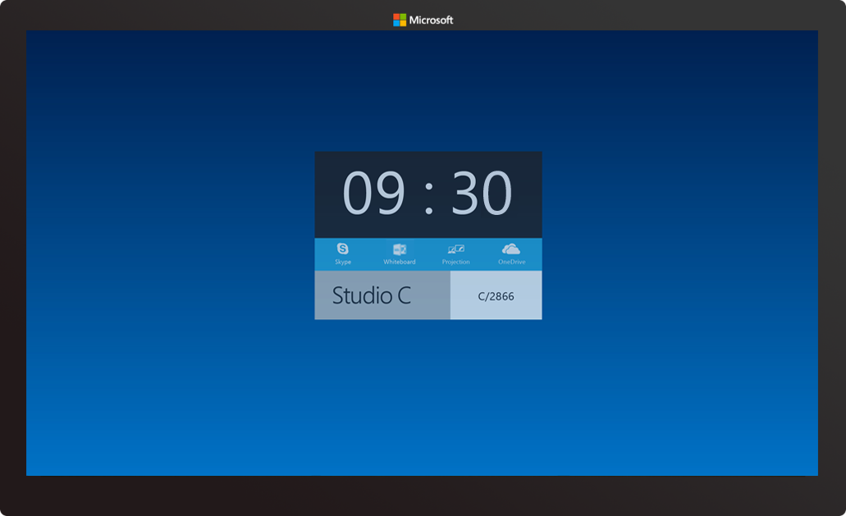
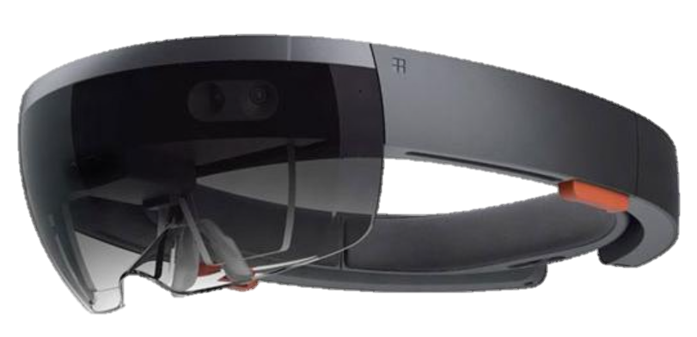

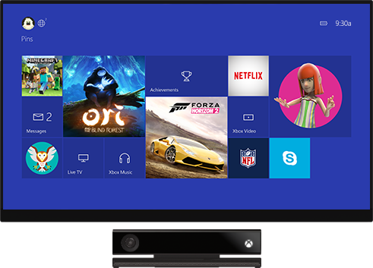
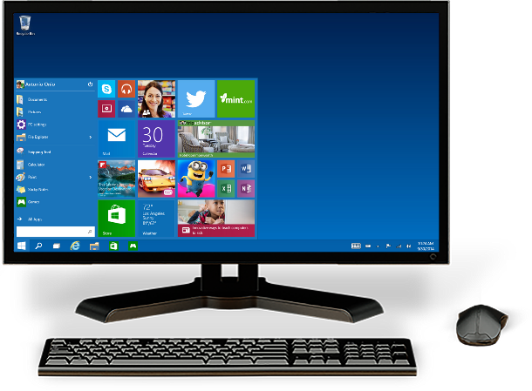
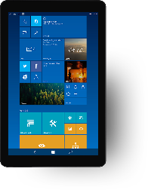
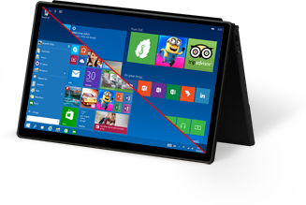
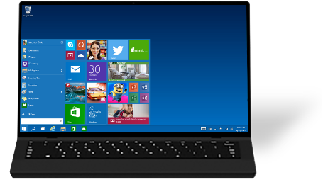

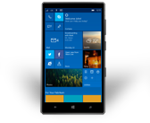
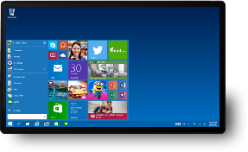
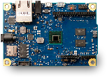
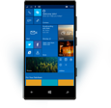
One product family
One platform
One store
Notes:
With Windows 10 we empower developers to reach their windows customers wherever they are and on whatever device they happen to be using. They can now build one app that runs on everything from tiny IoT devices like sensors, to mobile phones and phablets. Productivity devices like the Desktop PCs and 2-in-1s. New and exciting hardware like the HoloLens. Living room devices like the Xbox. Or even the new Surface Hub in a meeting room.
<click>
To make this ALL worthwhile for developers, we know we need to get Windows TEN to be BROADLY adopted In fact, our GOAL is that within TWO to THREE years of Windows 10’s release, there will be ONE BILLION devices running Windows 10

Slide 17
Construct 2

Slide 18
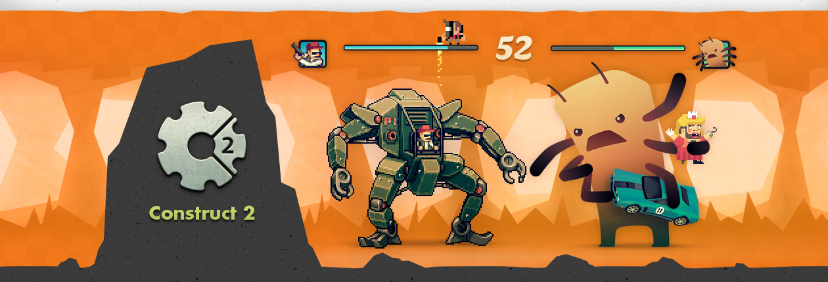
What is Construct 2?
Construct 2 is a powerful HTML5 game creator for 2D games.
Notes:
HTML5 – runs in your browser, see this later
Can make really cool games under an hour

Slide 19



Why Construct 2?
Free
Fun, powerful + easy to learn (even for non-programmers!)
Doodlejump, Flappy bird, Jetpack Joyride, Candy Crush, etc.
Game can be published as a website/app
Notes:
Very accessible to students, Who doesn’t like free stuff
v. Beginner friendly
Even if you’ve never coded before, construct 2 will give great exposure to the logic behind making a game, so that you can then go on and make more complex games
Fun and engaging way to learn programming principles
Share w/others, make $

Slide 20







Publish Anywhere…
Notes:
Construct 2 publishing
HTML5 website -> web server
Scirra Arcade
WP8 or Windows 8
PhoneGap -> iOS or Android

Slide 21




Notes:
So we have learnt construct 2 now, how many of you know about C#? Get answers from students - explain to them basically what C# is.
Could even tell them about visual studio or xamarin
Cross platform apps
Universal apps on windows store

Slide 22
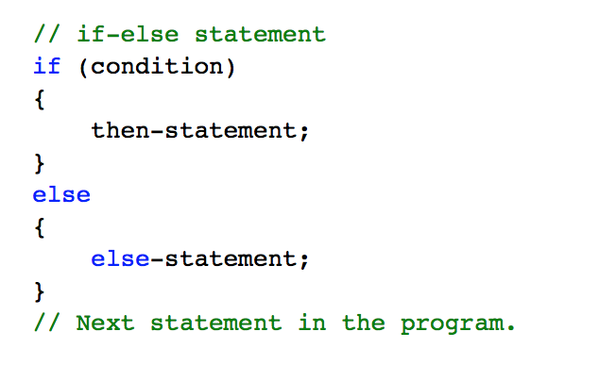
If-else statement in C#
Notes:
Tell the students who are new to this that it’s not scary give them an analogy, tell them think of this like English. Give them an example for instance if you walk in the rain you get wet else you don’t get wet. This is a fundamental statement in programming and it is used in most programming languages
For those that have programmed tell them that it is very similar as you can see to other programming languages
In an if-else statement, if condition evaluates to true, the then-statement runs. If condition is false, the else-statement runs. Because condition can’t be simultaneously true and false, the then-statement and the else-statement of an if-else statement can never both run. After the then-statement or the else-statement runs, control is transferred to the next statement after the if statement.

Slide 23
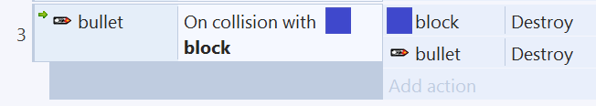

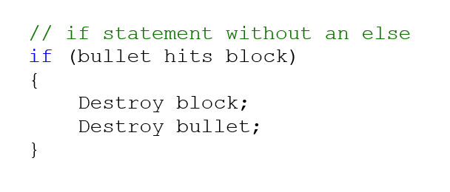

Slide 24
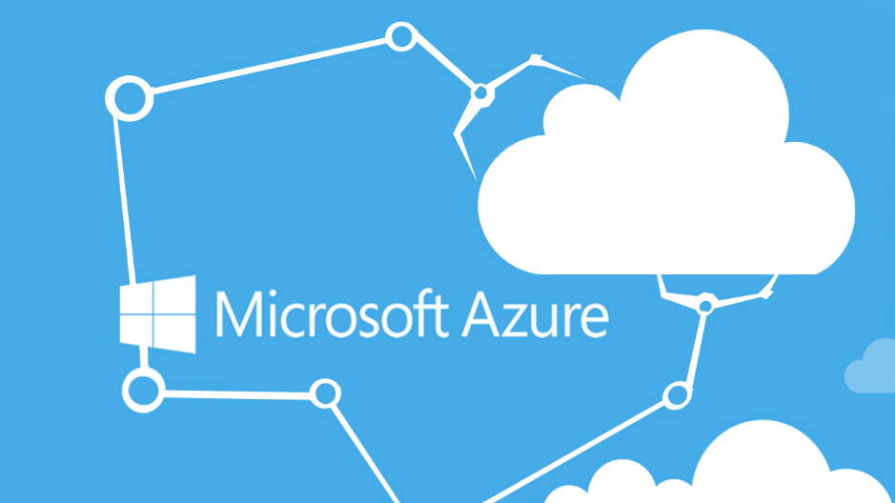
Notes:
This is where you will now move over to a browser and walk them through the steps on how to publish
Remember google chrome will create sub folders for you
Use Drop box if one drive throws an error.
This will then lead on to the help session where students can ask you help for there own game if you have time

Slide 25
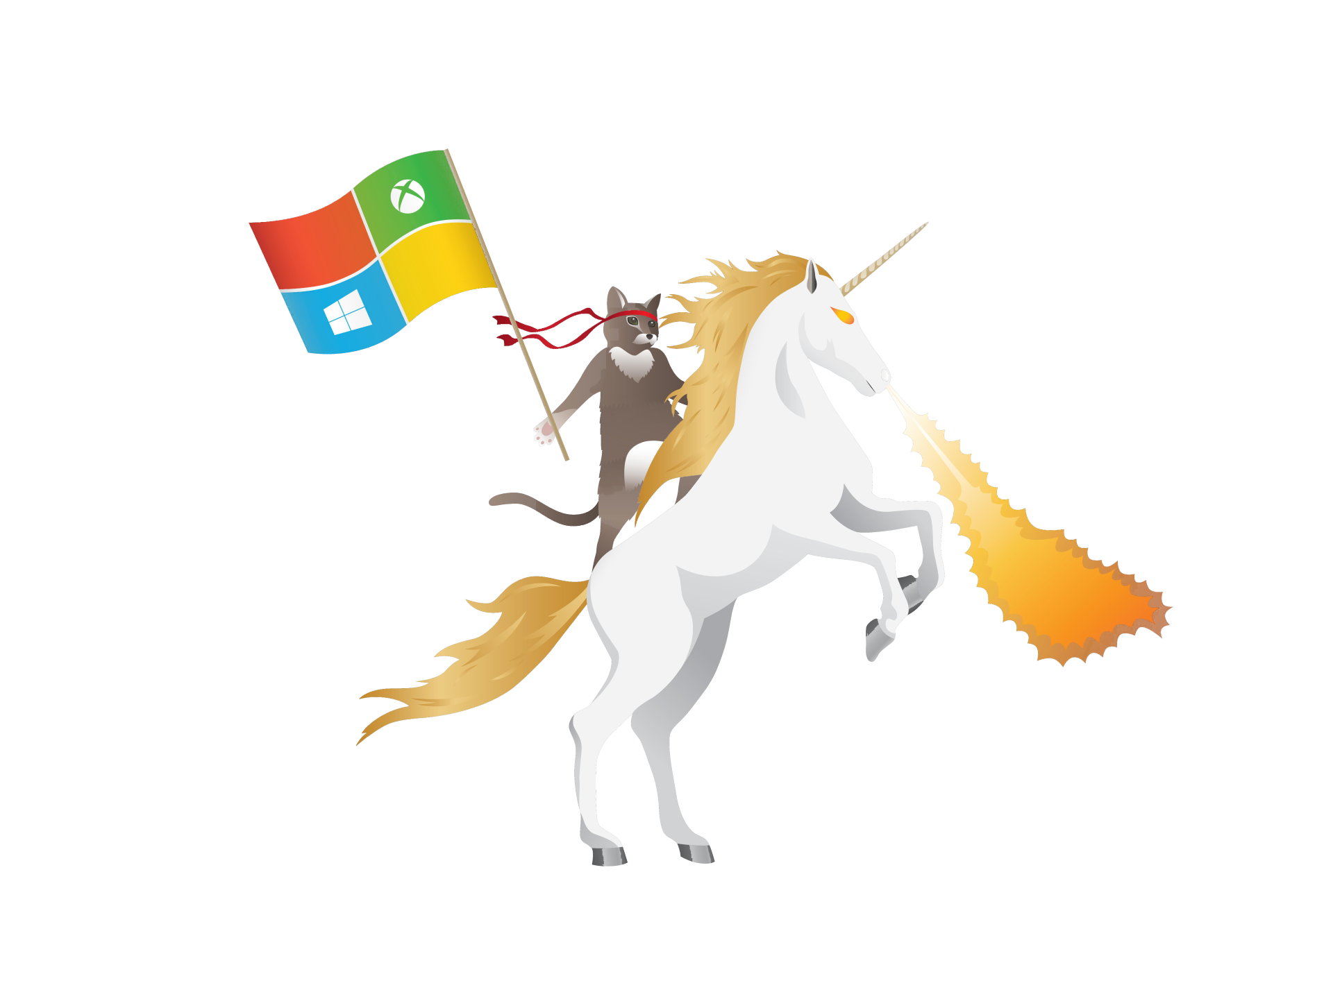
What will students be making?
ninjarunnergame.azurewebsites.net

Slide 26
Next Steps
Visit http://msa.ms/schools and Register now!
Watch all the videos (Homework)
Activate Microsoft Azure (Homework)

Slide 27
Thank you!

